Slide 1





OPHTHALMOLOGIST PRO
The Digital Revolution in Ophthalmology

Slide 2







MAIN
IDEA
The general idea of the progressive web app is to delve into the digitalization of the healthcare sector, which is perhaps one of the few industries resistant to technological advancements, still relying on paper prescriptions. Our goal is precisely to digitalize medical prescriptions and healthcare recommendations, making them accessible at all times to both healthcare providers and patients

Slide 3

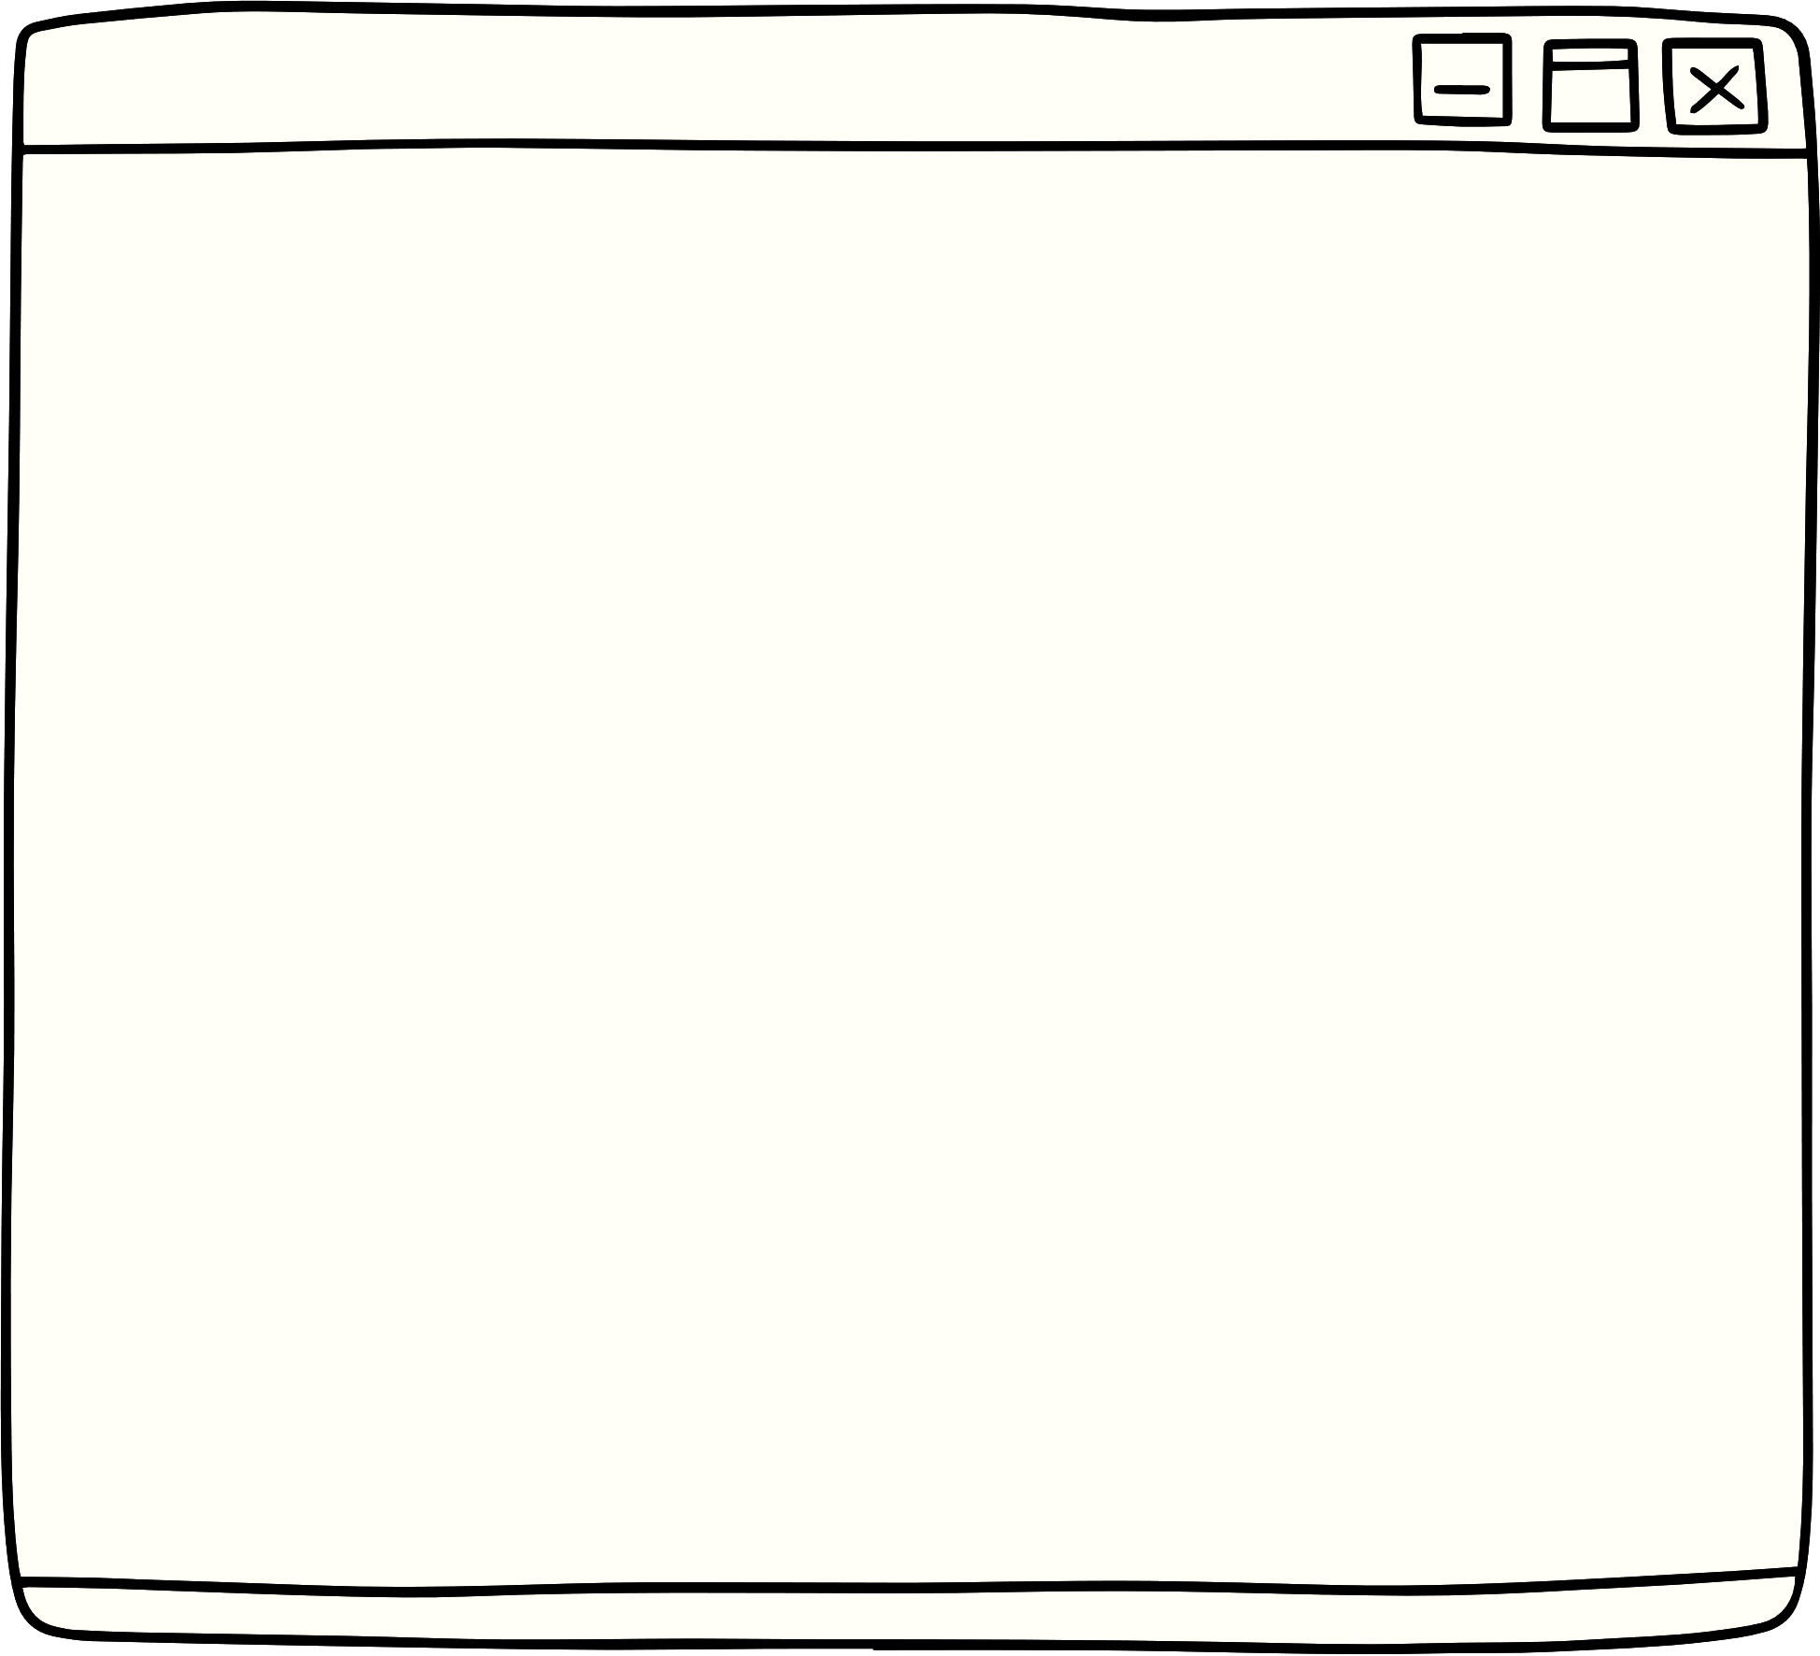
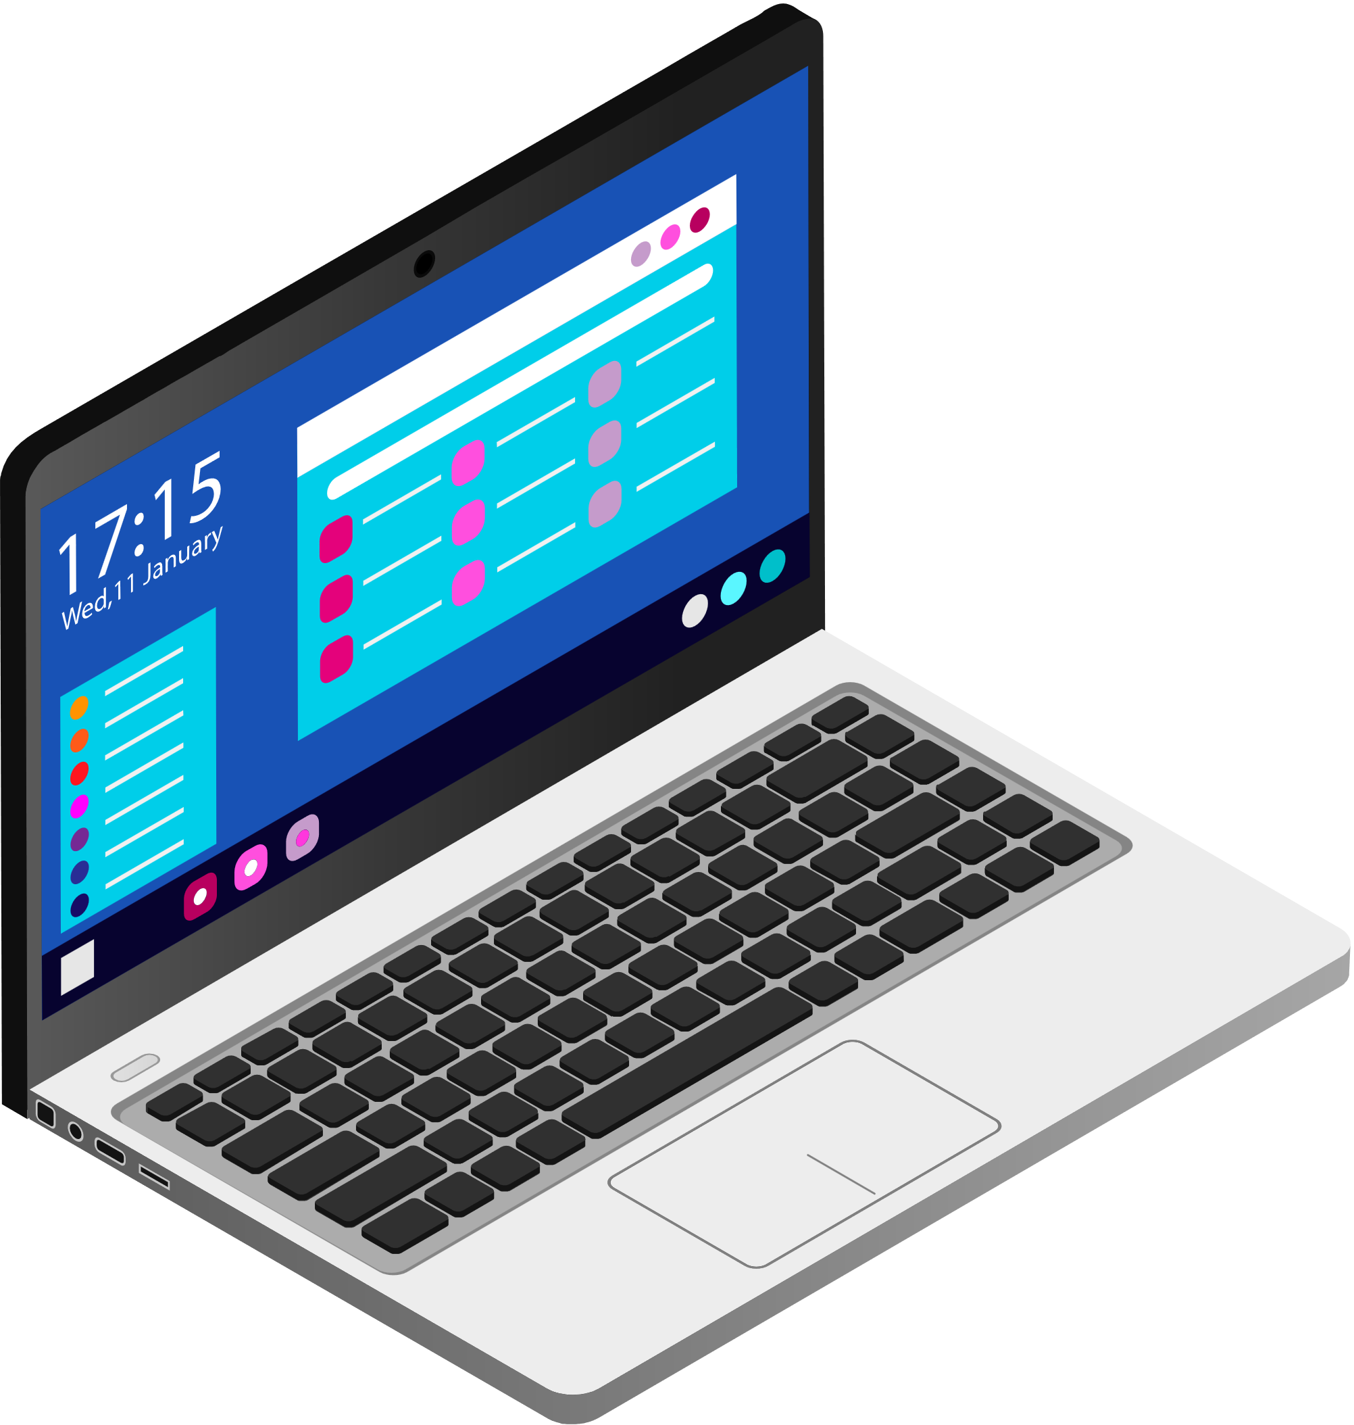
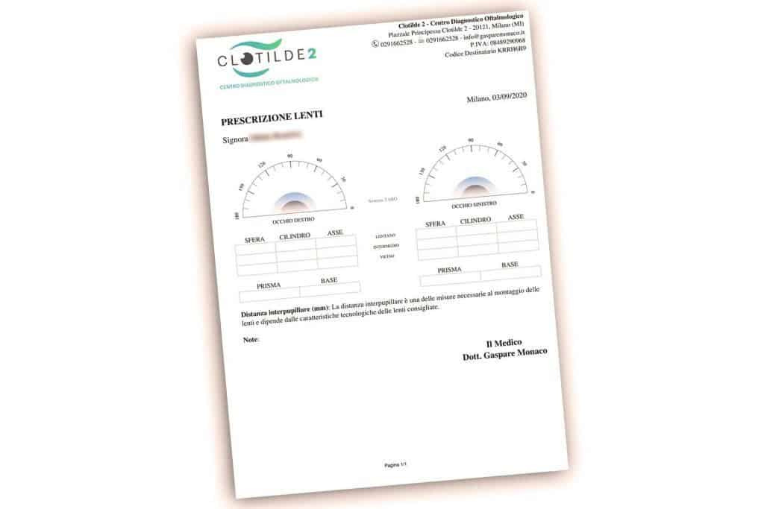




Our specific idea...
The specific idea is to digitize the prescription that an ophthalmologist provides to the patient at the end of an eye examination. This prescription includes the examination report with the recorded data and the type of eyeglasses, if needed. Through a progressive web app, instead of issuing a paper copy of the prescription, which is often prone to getting lost, we generate an online prescription that is accessible at any time by both the medical professional and the patient.

Slide 4




USERS
Admin
Medico
Patient
The admin of our website is the person responsible for managing and overseeing the various aspects of the site.
The doctor enters the patient visit data.
On our website, the patient is able to access the details of their past eye examinations and view the data related to their eye condition, including the exam results and the doctor's recommendations.

Slide 5



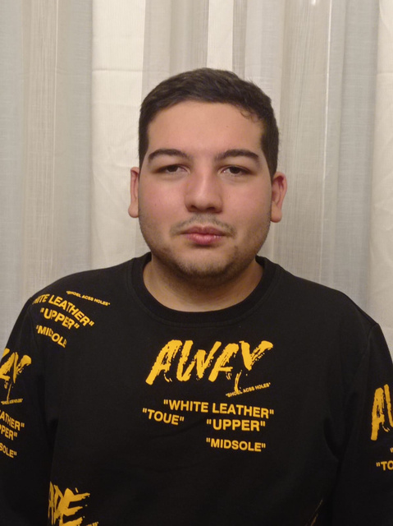

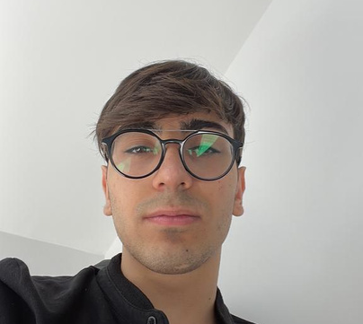











OUR TEAM
FRANCESCO PIO GRAVINO
PIETRO
SCHIAVONE
ANTONIO
IANNONE
Back to Agenda Page

